Slide 1
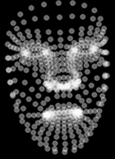
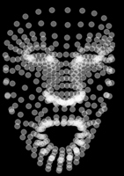
FacePoint Image Data
AUTOENCODER TRAINING
- 2DCNN_Autoencoder.ipynb
ENCODER
DECODER
V
Compressed Dimension
FacePoint Image Data
- Images_FacePoints_Gen.ipynb
FaceLandMarks Extraction
Face Point Image Generation
- FacePoints_GenProc.ipynb

Slide 2
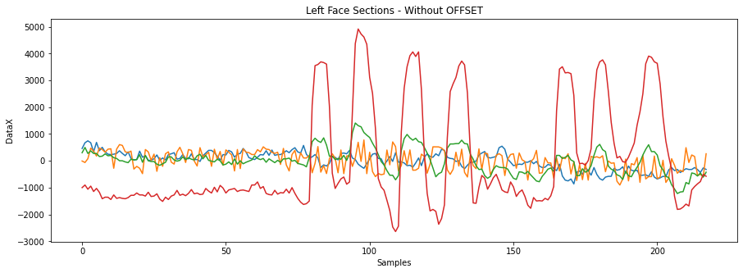
- Capacitive_Proc.ipynb
Capacitive Data
REGRESSOR TRAINING
- EncoderRegressor_Implementation.ipynb
REGRESSOR
Compressed Dimension
FacePoint Image Data
ENCODER
V
Only recordings with FaceShield for the Regressor.
Load Encoder from the previous trained autoencoder.

Slide 3
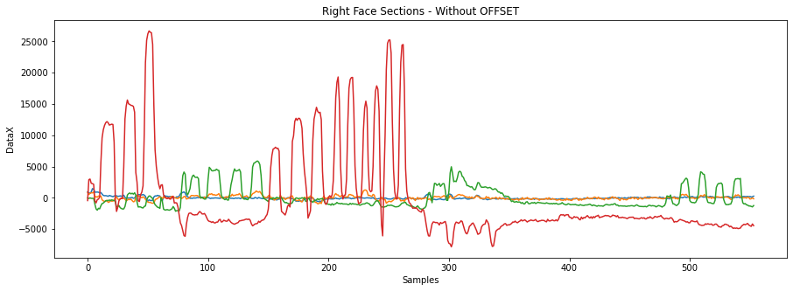
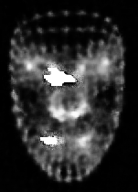
Capacitive Data
COMPLETE SYSTEM
- CompleteSystem.ipynb
REGRESSOR
DECODER
V
Compressed Dimension
FacePoint Image Data
RMSE

